Slide 1
Customer Segmentation
By Google BigQuery
Srisuda Wongvoraruj

Slide 2
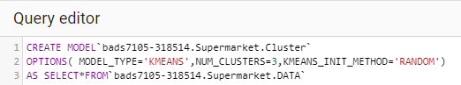
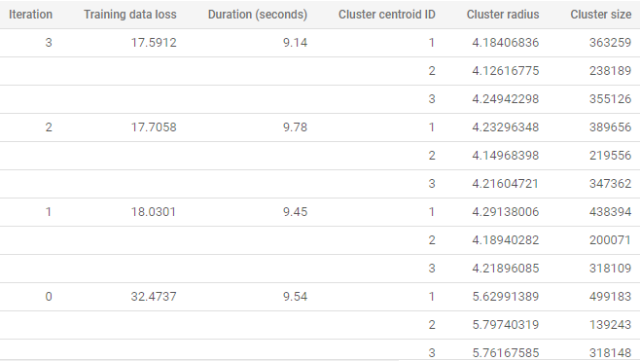
K-Means Clustering Model
CHOOSE CLUSTERS = 3
Result

Slide 3
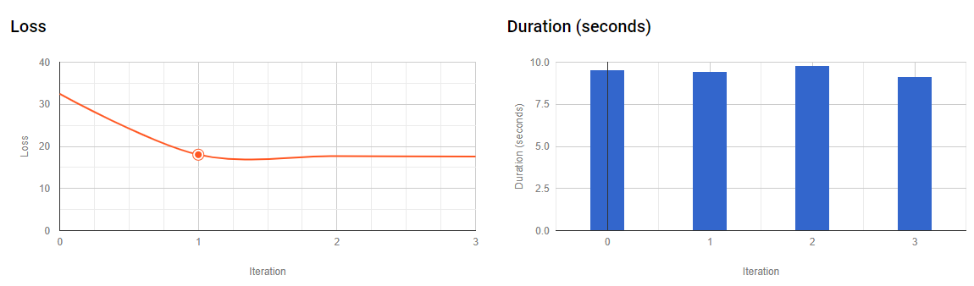
Results

Slide 4
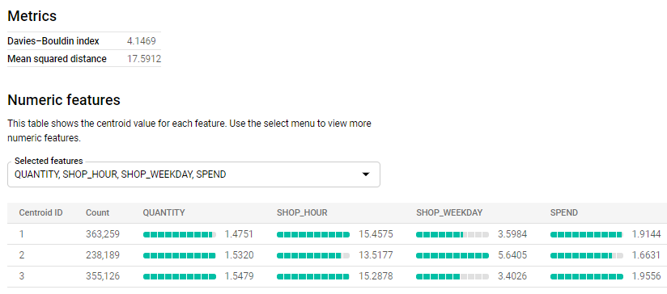
Results

Slide 5
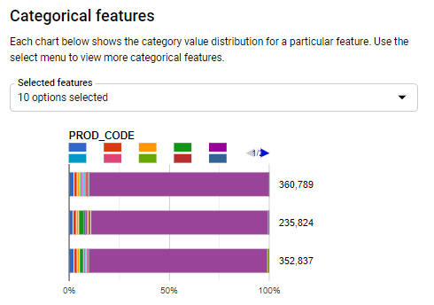
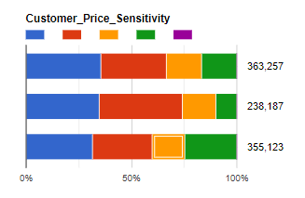
Results

